Slide 1
MRA Project Milestone 2
Contents
Exploratory Analysis of data
Market Basket Analysis (Association Rules)
Support, confidence, & lift values
Recommendations

Slide 2
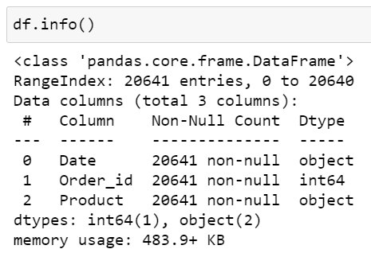
Data Description

Slide 3
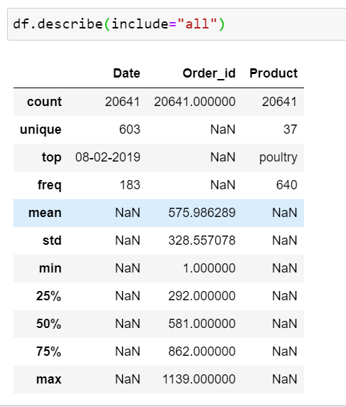

Slide 4
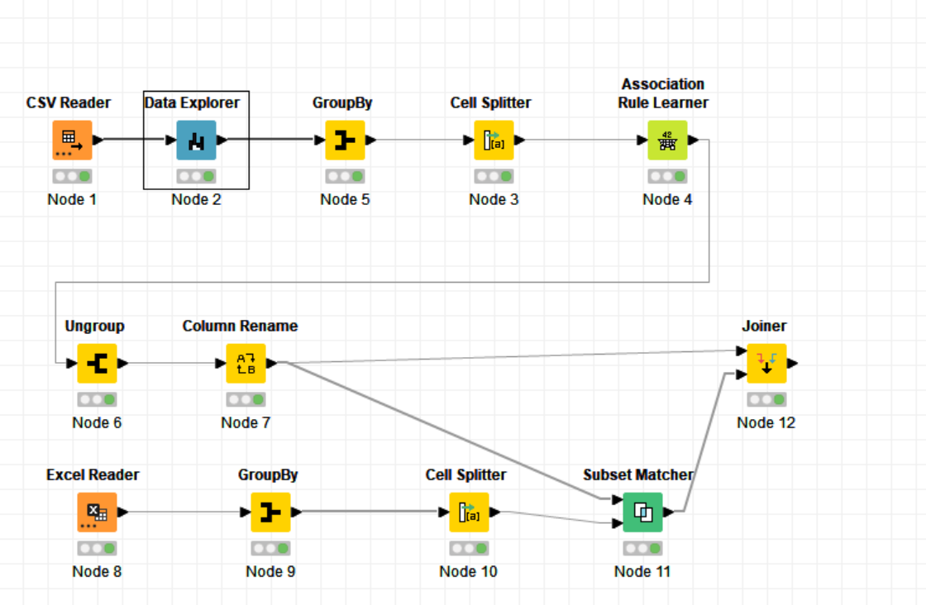
Threshold values of support and confidence are 0.05 and 0.5 respectively.

Slide 5
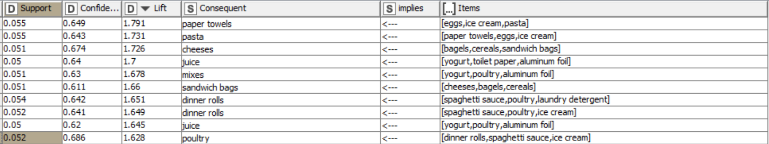
Below are the top 10 associations

Slide 6
Recommendations
Paper towels has maximum lift, so can be offered to or sold in combo deals with eatries.
Poultry , pasta , eggs, ice cream can be offered with dinner items.
Cereals, juice, cheese can be sold in combo with breakfast items.

